Slide 2
High Performance AI (HPAI) @ LRZ 18.06.2019 | Dr. David Brayford

Slide 3
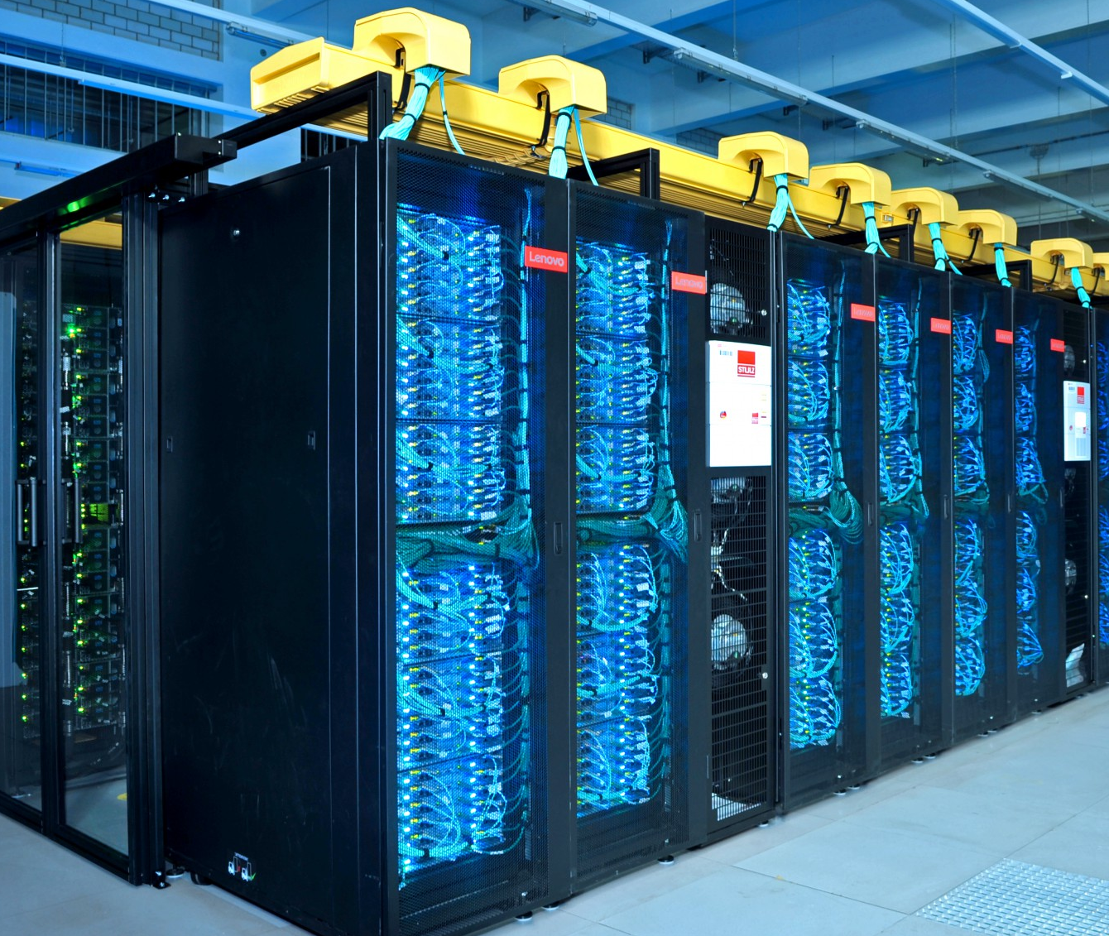
SuperMUC-NG (Next Generation)
LRZ HPC
Specs
Peak Performance 26.7 Pflop/s
719 Tbyte main memory and
70 Pbyte disk storage
6,480 Lenovo ThinkSystem nodes with Intel Xeon processors (Skylake)
311,040 compute cores
Intel Omni-Path interconnects
Direct hot water cooled + Adsorption coolers (47 C)
HPC + Cloud
Usage of own and individual virtual machines (integrated cloud)
Pre- and post- processing with user’s individual software
Integrated development, ability to use familiar software and tools
Remote visualization and integration to V2C

Slide 4
Application Mix – General Purpose, Broad Use
LRZ User Application Profile
Computational Fluid Dynamics Optimisation of turbines/wings, noise reduction
Material Science Semiconductors
Fusion
Plasma in a future fusion reactor (ITER)
Chemistry
Catalytic reactions
Astrophysics
Origin and evolution of stars and galaxies
Medicine and Medical Engineering
Blood flow, aneurysms, air conditioning
Solid State Physics
Superconductivity, surface properties
Biophysics
Properties of viruses, genome analysis
Geophysics
Earth quake scenarios
Climate research
Currents in oceans

Slide 5
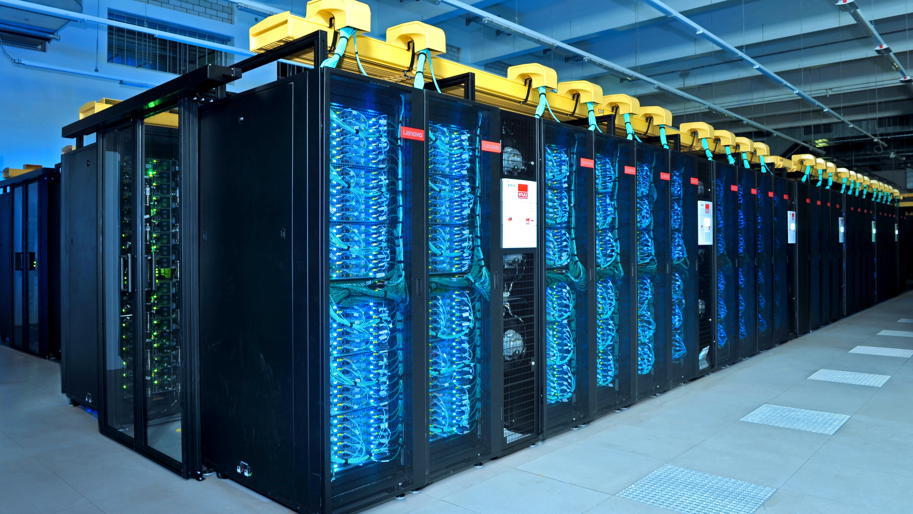
A New World is Emerging: High Performance AI (HPAI)
New User Communities with New Workflows
Ability and Expertise to Target Large Scale Problems
HPC
Big Data and AI

Slide 6
High Performance AI (HPAI) in a Container
Transition AI algorithms from the
laptop to supercomputer
with minimal effort
“It just works”

Slide 7
HPAI =
+
M&S
Analytics
Equation based on model
Computing driven
Numerically intensive
Creates simulations
Monte Carlo
Larger problems
Iterative methods
PDE
Finds patterns
Correlations in data
Logic driven
Creates inferences
Knowledge discovery
Graphs
Data-driven science
Predictions
CNN
RNN
Linear algebra
Matrix operations
Iterative methods
Compute intensive
Data transfer
Predictive
Probabilities
Stencil codes
Calculus
Pattern recognition
Graphs

Slide 8
Requirements for AI on HPC
HPAI@LRZ
Compute intensive hardware
Optimized AI frameworks TensorFlow, Caffe
Optimized software numerical libraries, Python
HPC specific software
distributed computing, workload manager
Method of deploying the AI software
in a simple, straight-forward and flexible way
Need to get to: “It just works”

Slide 9

Key Challenges
HPAI@LRZ
Package Management
Frameworks have conflicting dependencies
The frameworks & their dependencies need to be combined in a single module
Rapid update cycles
Provide a mechanism for users to build there own frameworks
Dynamic Programming Environment
Python dependencies
Each unique framework needs its own Python instance
Connecting to external servers
Build frameworks on systems with internet access

Slide 10

Charliecloud containers in HPC
HPAI@LRZ
Easy to install
Charliecloud was developed to be run on highly secure HPC systems at US government labs
Charliecloud runs entirely under the User ID
Ability to run legacy design flows in containers
Low overhead and ~ 800 lines of code
LRZ deploys Charliecloud via Spack
Charliecloud is available in the module system at LRZ

Slide 11
Achieving High Performance AI on Secure HPC Systems
Deployment@LRZ
Mechanism for deploying AI at LRZ
Download the Intel optimized TensorFlow Docker Image (intelaipg Dockerhub)
Modify the Linux Docker image for HPC
Modify Python to enable distributed TensorFlow execution
Copy the training data and execution scripts to the modified Docker image
Convert to a Charliecloud UDSS and copy the file to the HPC system
Load the Charlicloud module
Execute on SuperMUC-NG via Slurm

Slide 12
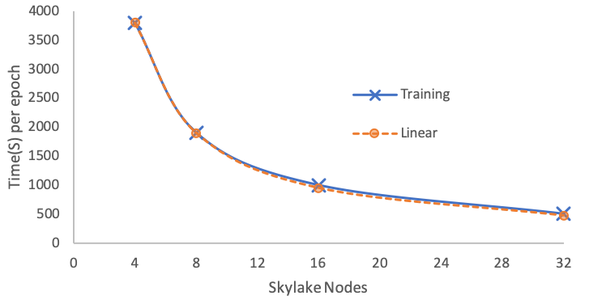
Distributed TensorFlow Results
Deployment @ LRZ
Example execution line in the Slurm script:
mpirun –np 32 –ppn 4 ch-run –w </path/to/my_image> --python <path/train.py>

Slide 13
Achieving High Performance AI for the community
Collaboration
Intel provides optimized components
Intel® MPI Library
Intel® Math Kernel Library
Intel® Compilers
Optimized third-party software
Developer version containing Intel® VTune™ Amplifier and Intel® Advisor
LRZ turns them into vertically integrated containers
System specific (drivers, runtimes, …)
User-focused set of software modules
Semi-automated conversion process
Focused on latest versions of tool kits
With packaging expertise for ease-of-use
Together
Demonstrate vertically integrated solutions on showcase applications highlighting HPAI
Conduct BoF, presentations, workshops and tutorials
Create a community-focused HPC/AI benchmark suite
Container recipes, best practices

Slide 14
Third Quarter 2019
Future
Release SC’19 Denver
HPC suitable Intel optimized TensorFlow Docker image
Verified recipes to enable the deployment of AI on HPC systems using secure containers
Github repository https://github.com/DavidBrayford/HPAI

